Slide 1
Input Devices
Input devices are those devices from which we can input data and instructions into the computers. A number of input devices have been developed.

Slide 2
Input devices
keyboard

Slide 3

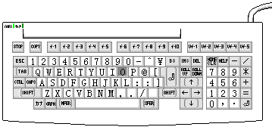
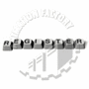
KEYBOARD
It is most commonly used input device. It is used to input data into written form. Keyboard is merely a collection of momentary switches.

Slide 4
Input devices
keyboard

Slide 5
Input devices
keyboard
Normal
keyboard

Slide 6
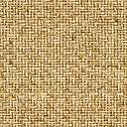
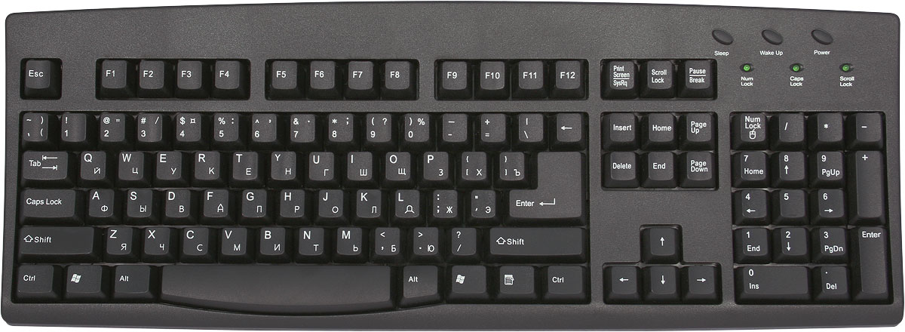
NORMAL KEYBOARD
A normal keyboard has 101-104 keys which are distributed in five categories.
Function keys F1 to F12
Alphanumeric keys A-Z, a-z, 0-9
Special keys Alt, Ctrl, Enter, Insert, Home, End, Esc etc.
Numeric keypad 0-9,+,-,*,%,@ etc.

Slide 7
Input devices
keyboard
Normal
keyboard
Multimedia keyboard

Slide 8
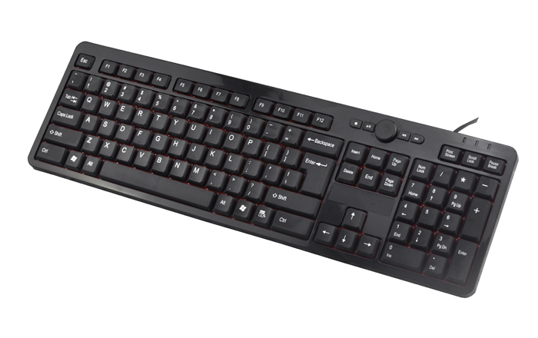
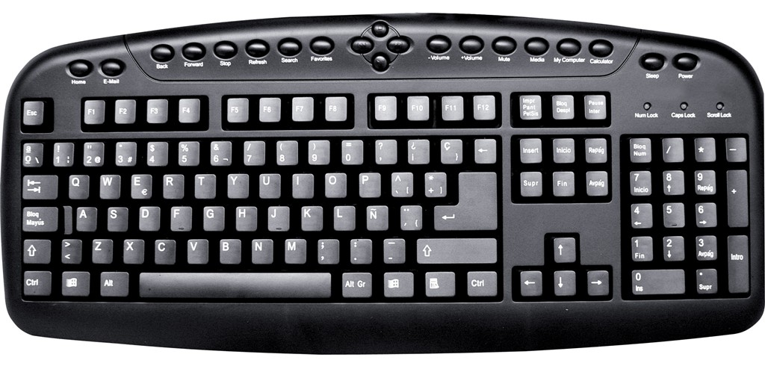
MULTIMEDIA KEYBOARD
Multimedia keyboard has some additional keys to operate multimedia operations like volume up, volume down, play, pause, stop etc.

Slide 9
Input devices
mouse
keyboard
Normal
keyboard
Multimedia keyboard

Slide 10


MOUSE
It is a pointing device used to insert instructions into the computers. It is a hand held device that controls the pointer on the screen. It has two buttons viz. left button & right button & one scrolling wheel. With the help of mouse you can draw images, select options & move text & images.

Slide 11
Input devices
mouse
keyboard
Traditional
mouse
Normal
keyboard
Multimedia keyboard

Slide 12


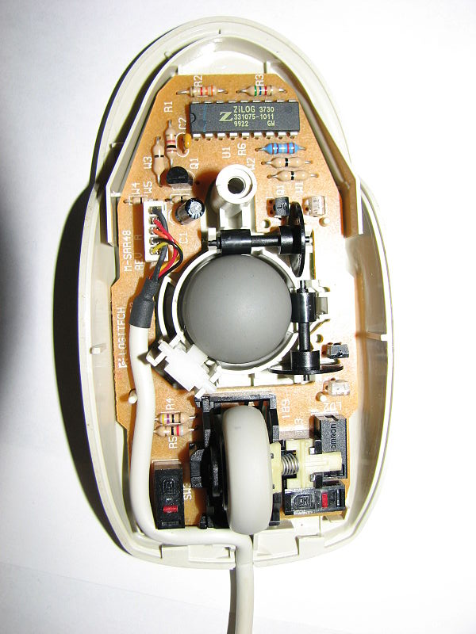
TRADITIONAL MOUSE
Traditional mouse is used a ball built into the bottom with two small rollers placed two sides of the ball at 90 degree angle from each other. They spin when the ball rolls. A sensor detects how much each roller spins and sends the information to computer and the pointer on the screen moves into the same direction.

Slide 13
Input devices
mouse
keyboard
Traditional
mouse
Optical mouse
Normal
keyboard
Multimedia keyboard

Slide 14

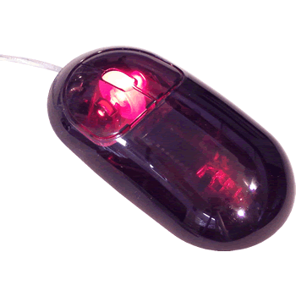

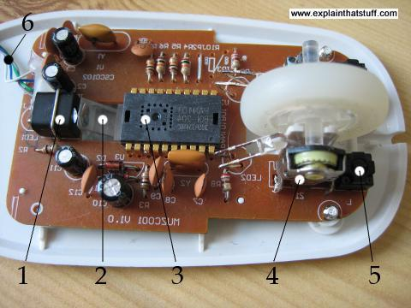
OPTICAL MOUSE
Optical mouse is a advance pointing device that uses a light diode (LED)(1), an optical sensor (2) and a digital signal (3) processing in place of traditional mouse ball. Optical mouse need plan surface to produce high performance efficiency. Each time the mouse is moved, the beam of light is interrupted by the surface.

Slide 15
Input devices
mouse
keyboard
Traditional
mouse
Optical mouse
Normal
keyboard
Multimedia keyboard

Slide 16
Input devices
mouse
keyboard
joystick
Traditional
mouse
Optical mouse
Normal
keyboard
Multimedia keyboard

Slide 17
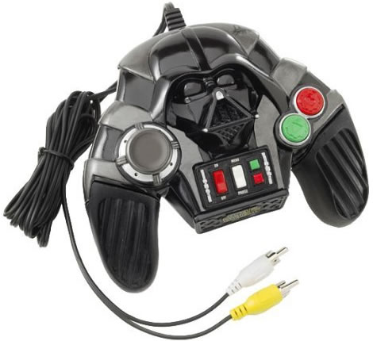
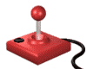


JOYSTICK
Joystick is a pointing device mostly used for playing games. This is a device used to control the actions in a computer game. It consist of a lever used to move the pointer on the screen and buttons used to select options.

Slide 18
Input devices
mouse
keyboard
joystick
Traditional
mouse
Optical mouse
Normal
keyboard
Multimedia keyboard

Slide 19
Input devices
mouse
Touch screen
keyboard
joystick
Traditional
mouse
Optical mouse
Normal
keyboard
Multimedia keyboard

Slide 20

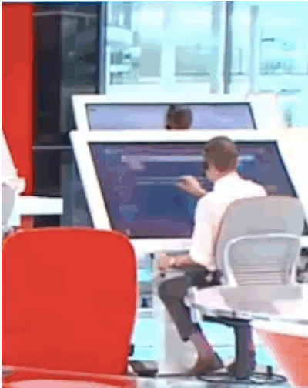
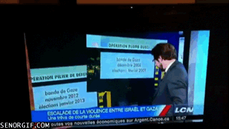
TOUCH SCREEN
Touch screen is the easiest way to data input into computer. Touch screen allows the user to select the item by touching the screen at appropriate spot. It has another feature that the user’s finger become the input device to operate touch screen.

Slide 21
Input devices
mouse
Touch screen
keyboard
joystick
Traditional
mouse
Optical mouse
Normal
keyboard
Multimedia keyboard

Slide 22
Input devices
mouse
Touch screen
keyboard
joystick
microphone
Traditional
mouse
Optical mouse
Normal
keyboard
Multimedia keyboard

Slide 23
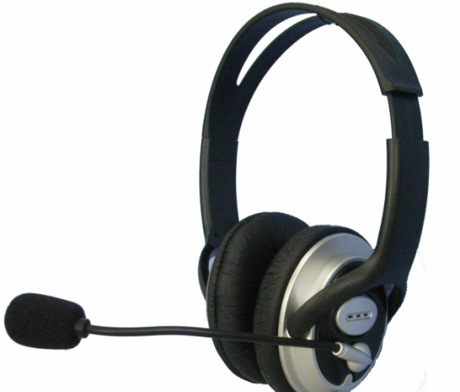
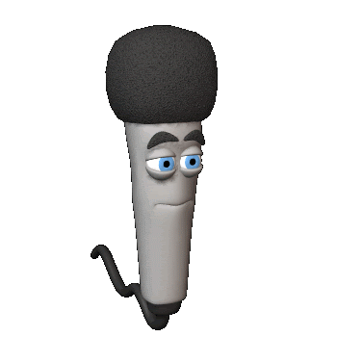
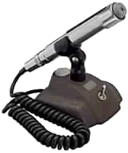
MICROPHONE
Microphone is an input device used to inputting the voice signal into the computer. microphones are commonly used for live chat. Microphones are also used to record voice into the computer.

Slide 24
Input devices
mouse
Touch screen
keyboard
joystick
microphone
Traditional
mouse
Optical mouse
Normal
keyboard
Multimedia keyboard

Slide 25
Input devices
mouse
Touch screen
scanner
keyboard
joystick
microphone
Traditional
mouse
Optical mouse
Normal
keyboard
Multimedia keyboard

Slide 26

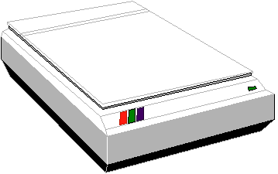
SCANNER
Scanner is an input device used to insert a picture into the computer. This is a peripheral device that converts a printed image into digital information. There are two types of scanners:

Slide 27
Input devices
mouse
Touch screen
scanner
keyboard
joystick
microphone
Traditional
mouse
Flat bed scanner
Optical mouse
Hand held scanner
Normal
keyboard
Multimedia keyboard

Slide 28
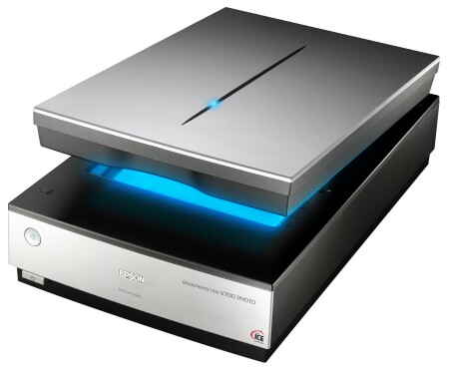
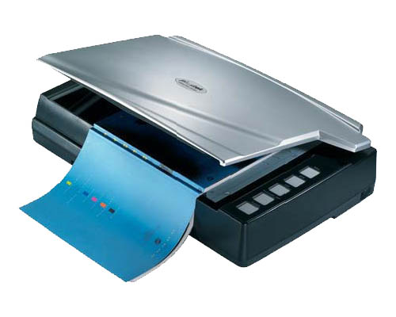
FLAT BED SCANNER
A flat bed scanner uses a flat surface just like photocopier. We can place a picture on the surface of the scanner:; scanner scans the image and convert into digital form. The picture can be seen on the monitor screen after scanning.

Slide 29
Input devices
mouse
Touch screen
scanner
keyboard
joystick
microphone
Traditional
mouse
Flat bed scanner
Optical mouse
Hand held scanner
Normal
keyboard
Multimedia keyboard

Slide 30
Input devices
mouse
Touch screen
scanner
keyboard
joystick
microphone
Traditional
mouse
Flat bed scanner
Optical mouse
Hand held scanner
Normal
keyboard
Multimedia keyboard
Bar code reader

Slide 31
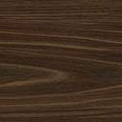
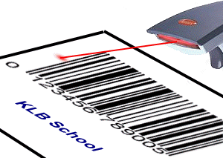
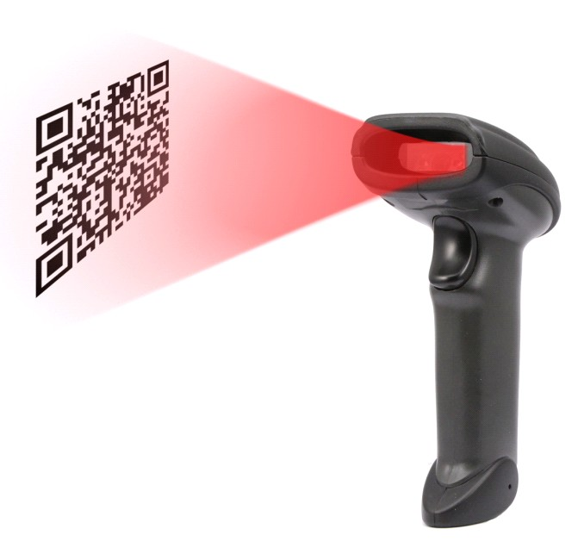
Bar code reader
Bar code reader are used to read the values printed on the product in form of vertical lines. Bar codes are recorded on the products by the manufacturers and usually carry the product number.

Slide 32
Input devices
mouse
Touch screen
scanner
keyboard
joystick
microphone
Traditional
mouse
Flat bed scanner
Optical mouse
Hand held scanner
Normal
keyboard
Multimedia keyboard
Bar code reader

Slide 33


